Slide 1
Dienstag, den 21. April
Musik in Deutschland
Learning objective: To be able to understand facts about music in Germany.

Slide 2
Welche Art von Musik hörst du?
Rock
Jazz
Folk
klassische
Indie
Partnerarbeit: Kennt ihr schon deutsche Komponisten oder Musiker?

Slide 3
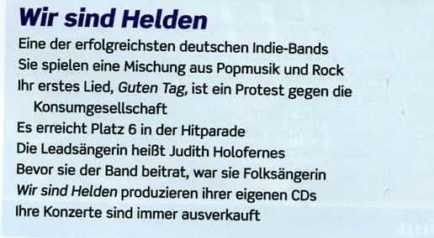
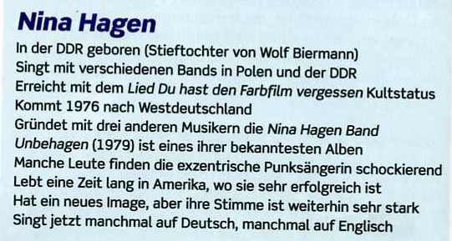
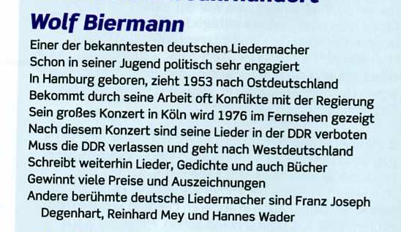

Slide 4

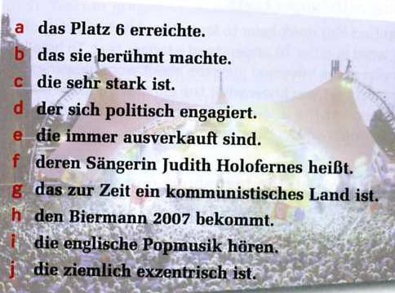
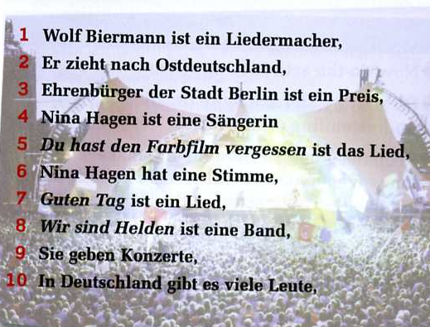
Satzhälftenverbindung

Slide 5
Relative pronouns
Relative pronouns mean ‘who’ or ‘which’ and are used to join sentences together.
The relative pronoun agrees with the noun to which it refers and takes its case form the role I plays in the relative clause.
In English, you can sometimes leave out the relative pronoun. In German, you never can.
 | masc | fem | neut | pl
nom | der | die | das | di
acc | den | die | das | die
dat | dem | der | dem | denen
gen | dessen | deren | dessen | deren

Slide 6
The sentences you just matched up all contain relative pronouns. Translate these into English.

Slide 7
Hausaufgaben
Choose a band/singer (English or German) and write 150 words about them to present in class on Thursday. Feel free to find a youtube clip of the band to go with your presentation.
Include at least one relative pronoun in your presentation.
Prepare 3 questions to ask the others at the end of your presentation.

